Slide 1
Intelligent Systems
Litty Tressa George
Lecturer FICT
Section 4 PPT 1

Slide 2
Agent Based Systems
Contents
Introduction
Agent Properties
Agent Classification
Agent Architectures

Slide 3
What is an Agent?
An agent is a entity that carries out some task or tasks on behalf of a human, usually to help a human user.
The agents sense the environment through sensors and act on their environment through actuators.
Examples of Agent:-
A software agent has keystrokes, file contents as sensory input and act on those inputs and display output on the screen.
A Human agent has eyes, ears, and other organs which act as sensors and hands, legs, mouth, and other body parts acting as actuators.
A Robotic agent has Cameras and infrared range finders which act as sensors and various motors/mechanical structures acting as actuators.

Slide 4
A software agent is an agent that exists solely as a computer program.
Agent = Architecture + Agent Program
Architecture is the machinery that the agent executes on.
It can be a device with sensors and actuators, for example
: a robotic car, a camera, a PC.
Agent program is an implementation of an agent function.
An agent function is a map from the percept sequence(history of
all that an agent has perceived till date) to an action.

Slide 5
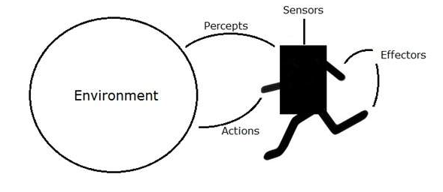
Agent & Environment
The agents sense the environment through sensors and act on their environment through actuators.
An Agent runs in the cycle of perceiving, thinking, and acting.

Slide 6
Intelligent Agents
An AI system is composed of an agent and its environment. The agents act in their environment. The environment may contain other agents too.
Intelligent agents have more knowledge or understanding of their environment than simple agents and are able to use this intelligence to carry out their tasks more effectively.
An AI agent can have mental properties such as knowledge, belief, intention, etc.
“an agent is a computer that is situated in some environment, and is capable of autonomous action in this environment in order to meet its delegated objectives” (Michael John Wooldridge)

Slide 7
Following are the main four rules for an agent to be AI agent :
Rule 1: An AI agent must have the ability to perceive the environment.
Rule 2: The observation must be used to make decisions.
Rule 3: Decision should result in an action.
Rule 4: The action taken by an AI agent must be a rational action.

Slide 8
Agent Terminology
Performance Measure of Agent − It is the criteria, which determines how successful an agent is.
Behavior of Agent − It is the action that agent performs after any given sequence of percepts.
Percept − It is agent’s perceptual inputs at a given instance.
Percept Sequence − It is the history of all that an agent has perceived till date.
Agent Function − It is a map from the precept sequence to an action.

Slide 9
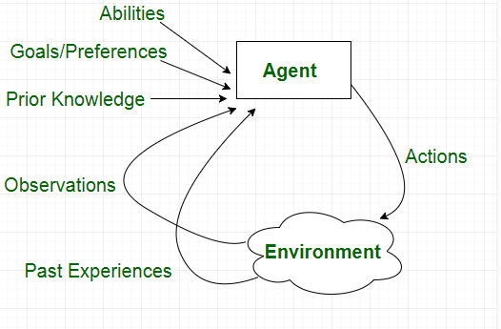

Slide 10
Properties Of Environment
The environment have multiple properties −
Discrete / Continuous − If there are a fixed number of distinct, clearly defined, states of the environment, the environment is discrete (For example, chess); otherwise it is continuous (For example, driving).
Observable / Partially Observable − If it is possible to determine the complete state of the environment at each time point from the percepts it is observable; otherwise it is only partially observable.
Static / Dynamic − If the environment does not change while an agent is acting, then it is static; otherwise it is dynamic.
Single agent / Multiple agents − The environment may contain other agents which may be of the same or different kind as that of the agent.

Slide 11
Properties Of Environment……
Accessible / Inaccessible − If the agent obtains the complete and accurate information about the state of the environment, then the environment is accessible to that agent.
Deterministic / Non-deterministic − If the next state of the environment is completely determined by the current state and the actions of the agent, then the environment is deterministic; otherwise it is non-deterministic.
Episodic / Non-episodic − In an episodic environment, each episode consists of the agent perceiving and then acting. The quality of its action depends just on the episode itself. Subsequent episodes do not depend on the actions in the previous episodes. Episodic environments are much simpler because the agent does not need to think ahead.

Slide 12
Properties of Agents
1 Intelligence
2 Autonomy
3 Ability to Learn
4 Cooperation

Slide 13
1 Intelligence
Intelligent agents have additional domain knowledge that enables them to carry out their tasks even when the parameters of the task change or when unexpected situations arise.
For example, an intelligent agent might be designed to buy books for a user on the Internet at the lowest possible price.
The agent would need to be able to interact with a set of online bookstores but would also need to be able to learn how to deal with new bookstores or with individuals who were offering secondhand books.

Slide 14
2. Autonomy
In addition to intelligence, an important feature exhibited by intelligent agents is AUTONOMY.
It is the ability to act and make decisions independently of the programmer or user of the agent.
For example, an intelligent buying agent that is designed to buy goods on behalf of a user needs to be able to make decisions about purchase without checking back with the user.

Slide 15
3. Ability to Learn
Many agents have an ability to learn.
That is , when presented with Learning ,allows agents to improve their performance at carrying out a particular task over time.
If a human user tells an agent that it has carried out a task poorly, it is useful for that agent to be able to learn from this experience to avoid making the same mistakes in the future. new information, such an agent is able to store that new information in a useful form.
For example, agents can learn from a user by observing actions or by being given instruction
Agents can also learn from other agents as in multiagent systems

Slide 16
4. Cooperation
In multiagent systems, agents usually cooperate with each other.
This cooperation implies some form of social interaction between agents.
For example, a buying agent may negotiate with selling agents to make purchases.
Of course, it is also useful for agents to cooperate with the humans who use them.

Slide 17
Other Properties of Agent
Agents can have a number of other properties. A versatile agent is one that is able to carry out many different tasks. Most agents are benevolent, but some can be competitive or nonhelpful.
Similarly, agents may be altruistic or antagonistic. Some agents can have the ability to lie to other agents, or to users ,whereas other agents are always truthful (this property is known as veracity).
Other properties of agents include the extent to which they can be trusted with delegated tasks and whether or not they degrade gracefully (i.e., when the agent encounters a new problem that it is unable to solve, does it fail completely, or is it able to make some progress?).

Slide 18
Agent Classifications
The main classes of agents are defined as follows:
Reactive agents
Collaborative agents
Interface agents
Mobile agents
Information-gathering agents

Slide 19
Reactive / Refex Agents
A simple reactive agent (also known as a reflex agent) is a production system where inputs from the environment are compared with rules to determine which actions to carry out.
In other words, reactive agents simply react to events in their environment according to predetermined rules.
A simple example of a reactive agent is the automatic mail filter that many e-mail systems now possess.
This mail filter examines each e-mail as it arrives and compares it against a set of rules, or templates, and classifies it accordingly.
A common use for such systems is to reject so-called “junk mail” or “spam.”

Slide 20
Reactive / Reflex Agents…………
More complex systems are used to route e-mails within an organization, so that a consumer can send an e-mail to a central mail address, and the system will determine to which department within the company to send the mail, based on its contents.
In the case of the e-mail–filtering agent, the environment is simply an email inbox and the contents of that inbox.

Slide 21
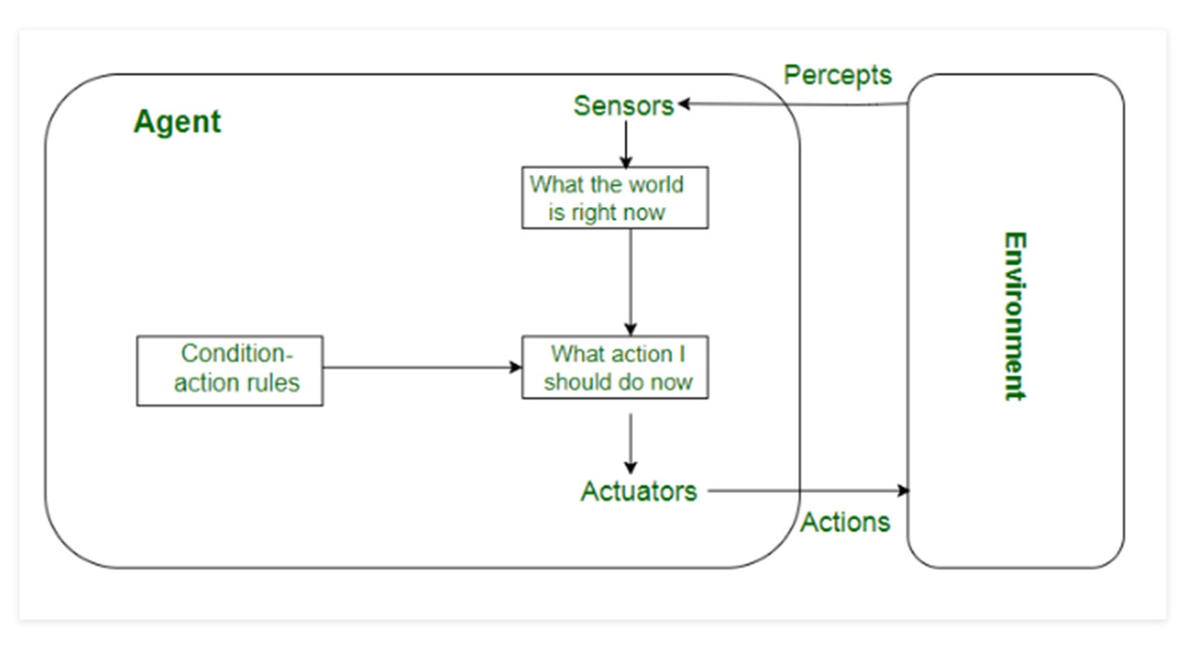

Slide 22
Goal-based Agents
Goal-based agents are more complex than reactive agents.
Rather than following a predetermined set of rules, a goal-based agent acts to try to achieve a goal.
This is often done by using search or planning.
A goal-based agent might, for example, be given the goal of finding pages on the Internet that are of interest to an Artificial Intelligence researcher
This goal based agent would search the Internet looking for pages that matched its criteria and would presumably report those pages to its owner or to a client.
This kind of agent does not take into account how efficiently it is searching or how relevant the pages are that it is finding. In other words, its aim is simply to satisfy its goal; it does not take into account how well it has satisfied the goal or how efficiently.

Slide 23
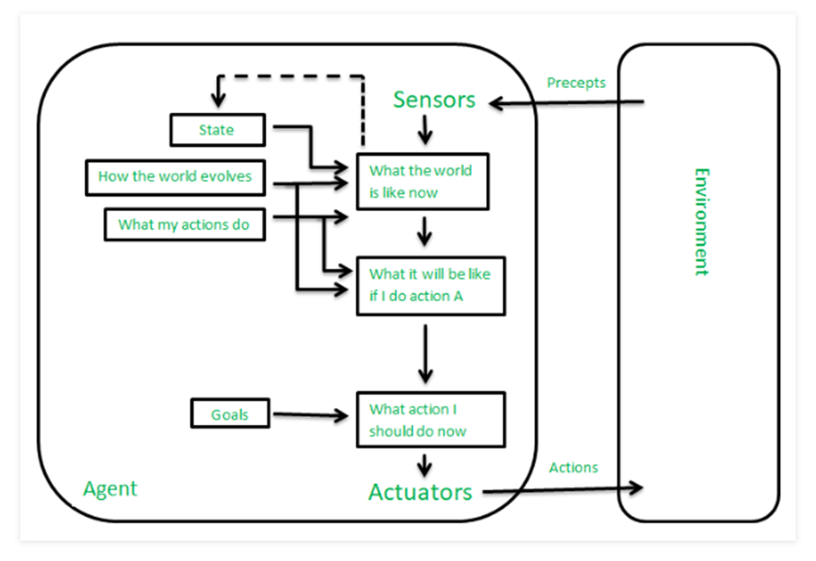

Slide 24
Utility-based Agent
A utility-based agent is similar to a goal-based agent, but in addition to attempting to achieve a set of goals, the utility-based agent is also trying to maximize some utility value.
The utility value can be thought of as the happiness of the agent, or how successful it is being.
It may also take into account how much work the agent needs to do to achieve its goals.
Let us return to our example from the previous section of an agent that searches for pages on the Internet that are of interest to Artificial Intelligence researchers. functions.

Slide 25
Utility-based Agent ……….
The utility-based agent can use knowledge about the Internet to follow the most worthwhile paths from one page to another.
In other words, it can use heuristic-based search techniques to minimize the amount of time it spends examining pages that are not of interest and to maximize the likelihood that if an interesting page exists, it will be found.
Utility based intelligent agents usually need sophisticated utility measure.

Slide 26
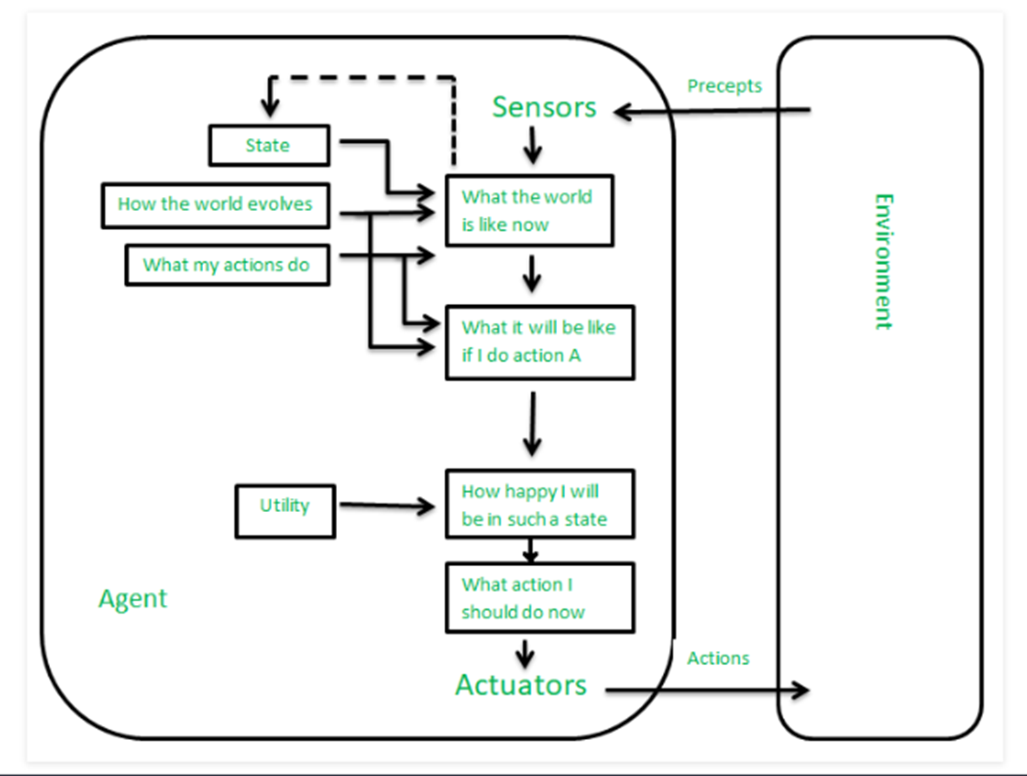
Utility-based Agent ……….

Slide 27
Utility Functions
A utility function maps a set of states to the set of real numbers.
In other words, given a particular state of the world, an agent is able to use its utility function to derive a score, or utility value, that tells it how “happy” it is in that state or how successful it has been if it reaches that state.
By searching through a tree of possible future states, based on available actions, and selecting a path that maximizes the utility function throughout the tree, a utility-based agent is able to achieve its goals effectively and efficiently.
For example, our Artificial Intelligence research agent might assign a high utility value to pages that are written in English and that appear to be written by a reliable source.
The idea of utility is closely related to the idea of rationality.
An agent that behaves rationally is one that attempts to maximize its utility function

Slide 28
Collaborative Agent Systems
Collaborative agent systems are multiagent systems in which the agents collaborate with each other to accomplish goals.
This property, of cooperating to achieve a common goal, is known as benevolence.
Collaborative agents typically do not have the ability to learn, although some have simple learning abilities.
As with multiagent systems, the idea is that a combination of many simple agents can solve a problem that each agent individually would not be able to solve.
Collaborative agent systems are able to take advantage of their parallel nature in order to solve problems faster than would otherwise be possible.
They are also more reliable than traditional systems because additional agents can be added to provide redundancy: if one agent fails, or provides incorrect information, this will not affect the overall performance of the system because other agents will provide corrective information

Slide 29
Interface Agents
An interface agent can be thought of as a personal assistant.
Typically, interface agents collaborate with the user, but do not need to collaborate with other agents; although in some cases, interface agents can learn by seeking advice from other agents.
A typical example of an interface agent is a tool that is used to help a user learn to use a new software package.
Such an agent has the ability to observe what the user does and
make suggestions for better ways to perform those tasks.
It is also able to assist the user in carrying out complex tasks, possibly learning as it does so. Interface agents can thus take instructions from users and can also learn from feedback from users about whether they are doing a good job or not, in order to perform better in future.

Slide 30
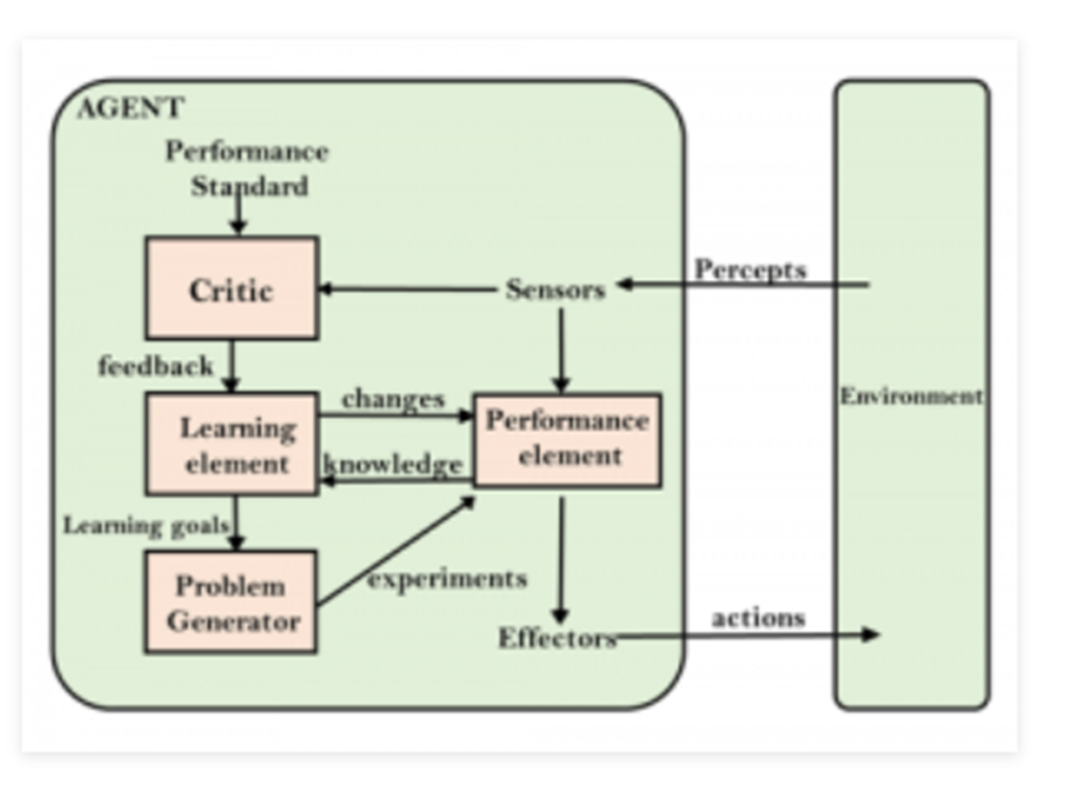
Ut

Slide 31
Mobile Agents
Mobile agents are those capable of “moving” from one place to another.
In the case of mobile robots, this literally means moving in physical space.
In the case of mobile software agents, this mobility usually refers to the Internet or other network.
An agent that is not mobile is static.
Mobile agents travel from one computer to another, gathering information and performing actions as needed on the basis of that information.
A computer virus can be thought of as a form of mobile agent, although most viruses are not intelligent, merely autonomous.
That is, they are able to act without being given direct instruction from a human, but they do not adapt intelligently to their surroundings—they simply follow a fixed set of rules that tells them how to infect a computer and how to reproduce.

Slide 32
Mobile Agents…..
For mobile agents to run on remote computers, a suitable environment must of course be provided that allows the agent to run on that machine.
An example of a system that provides such an environment is Telescript, developed by General Magic.
The Java programming language, developed by Sun, can also be used for developing mobile agents.
The idea that a mobile agent can be sent from one computer across the Internet to run on another computer raises many security questions.
The main advantages of mobile agents are efficiency ie; An agent that has to communicate with a number of remote servers and request large quantities of information in order to make a decision uses a large amount of bandwidth, which can be avoided if the agent is able to physically move to the remote server and query it locally.

Slide 33
Mobile Agents…..
Similarly, the mobile agent may be able to take advantage of superior computing power or the existence of particular functional abilities at the remote machine that are not present locally.
In this way, mobile agents can be used to generate a distributed computing architecture, where computation takes place on multiple computers at arbitrary locations.
A further advantage of mobile agents is that they can carry out their tasks asynchronously: the user can set a mobile agent off on a particular task and can then get on with other work, or maybe even switch the computer off.
When the user is ready to receive the results, the agent can be recalled

Slide 34
Information Agents
Information agents, also known as information-gathering agents, are usually used on the Internet and so they are also sometimes called Internet agents.
An information agent is used to help a user find, filter, and classify information from the vast array of sources available on the Internet.
Information agents may be static or mobile.
Some information agents are capable of learning, whereas the
behaviour of others is fixed.
Additionally, information agents can be collaborative or can work independently of other agents.
The distinctive feature of an information agent is the function that it provides, rather than the way it works.

Slide 35
Multiagent systems
Multiagent systems are a common way of exploiting the potential power of agents by combining many agents in one system.
Each agent in a multiagent system has incomplete information and is incapable of solving the entire problem on its own, but combined together, the agents form a system that has sufficient information and ability to solve the problem.
The system does not have a centralized control mechanism for solving
the problem.
Communication and collaboration are desirable properties of
multiagent systems.
Communication means, for example, that agents can inform each other of changes in the environment or of new discoveries they have made.
Collaboration means that agents can work together to solve a common goal.
An agent team is a group of agents that collaborate together to achieve some common goal.

Slide 36
Learning Agents
An agent that is capable of learning (a learning agent) is able to acquire new knowledge and skills and is able to use the new knowledge and skills to improve its performance.
One common way to provide agents with the ability to learn is to use Neural Networks.
A neural network is designed to learn in a similar manner to the way a human brain learns.
Another method for enabling agents to learn is to use Genetic Algorithms.
One way to use genetic algorithms in this way is to have the genetic
algorithm breed populations of agents, with the aim of breeding a highly successful agent.
Another way is to have each agent use a genetic algorithm to develop suitable strategies for dealing with particular problems.

Slide 37
Robotic Agents
Software agents exists in a virtual world.
Robotic agents, or robots, are artificial agents that exist physically in the real world.
Mobile robotic agents controlled by Brooks’ subsumption architecture
Robotic agents operate in an inaccessible, stochastic environment.
The real world has many properties that make the tasks of robotic agents much harder than those of many software agents.
An ability to deal with uncertainty as well as robustness in the extremely unpredictable and potentially dangerous environments.
Robots have been designed that build cars, using robotic arms and conveyer belts.

Slide 38
More sophisticated are the robots that are designed to explore other planets and collect samples for scientific analysis.
Such robots, of course, require autonomy: they cannot be controlled directly by human input because they would be too far away from the earth. One important aspect of such robots is their ability to walk: this involves not just knowing how to move legs in such a way as to move forward, but also how to navigate over hills and rocks, around pot-holes and through valleys.
Agents such as Atilla and Genghis, designed by the MIT MobotLab
(Mobot - “mobile robot”), have these abilities and are modeled
on insects.

Slide 39
Genghis has six legs and a number of sensors that enable it to determine certain facts about its inaccessible environment.
The interesting thing about Genghis is that nobody ever told it how to walk or steer around obstacles.
Its brain consists of 57 augmented finite state machines, each of which is responsible for a simple piece of behavior, such as lifting a leg or wandering.
Using these AFSMs and feedback from its sensors, Genghis was able to learn to walk from the experience of trying and failing to do so.

Slide 40
Agent Architectures
The main architectures of agents are defined as follows:
Reactive Architecture
Subsumption Architecture
Deliberative Architecture
BDI Architectures

Slide 41
Agent Architectures
Architectures can be used to build intelligent agents
The architecture of an agent is the way in which its various processing modules are connected together and the way in which those modules are connected to the environment in which the agent operates.

Slide 42
Reactive Architecture
Reactive agent architecture is based on the direct mapping of situation to action.
It is different from the logic-based architecture where no central symbolic world model and complex symbolic reasoning are used.
Agent responses to changes in the environment in a stimulus-response based.
The reactive architecture is realized through a set of sensors and effectors, where perceptual input is mapped to the effectors to changes in the environment.
Brook's subsumption architecture is known as the best pure reactive architecture (Brooks, 1986).
This architecture was developed by Brook who has critiqued on many of the drawbacks in logic-based architecture

Slide 43
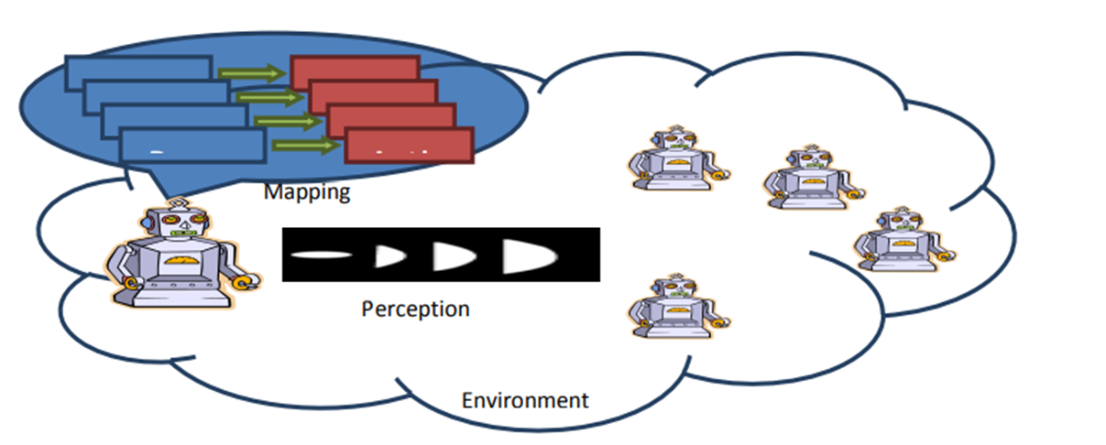
Figure 1 illustrates an example of reactive architecture. The figure shows that each of the percept situation is mapped into an action which specifically responses to the percept situation

Slide 44
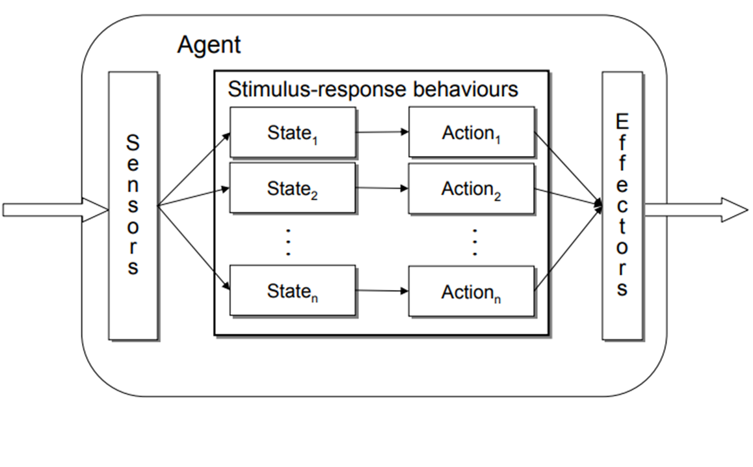
Reactive Agent

Slide 45
Subsumption Architecture
There are a number of architectures suitable for reactive agents.
One of the most commonly used is Brooks’ subsumption architecture (Brooks 1985).
The subsumption architecture is a layered architecture that was designed for implementing physical robots, which already don’t have any centralized intelligence or control mechanism.
The agent in this architecture has a set of inputs, a possible set of actions, and a layered set of modules, each of which is designed to control some aspect of the agent’s behaviour.
Each layer is able to inhibit the behaviour of layers below it.
The modules are augmented finite state machines (AFSM )which are similar to the finite state automata.

Slide 46
AFSM
AFSMs are often based on production rules, as used by expert systems, which take the form
input → action
These rules are called situated action rules or situation action rules because they map situations to actions.
An AFSM is triggered when its inputs exceed a threshold.
Each AFSM also has inhibitor inputs that can prevent it from triggering.
An AFSM is triggered when its inputs exceed a threshold

Slide 47
Subsumption Architecture
Each of the behaviour can be thought of as an individual function which maps changes in the environment with an action.
Multiple behaviours that can be fired simultaneously is another characteristic of subsumption architecture.
The subsumption architecture hierarchical structure represents different behaviours.
The lowest layer in the hierarchy has the highest priority.

Slide 48
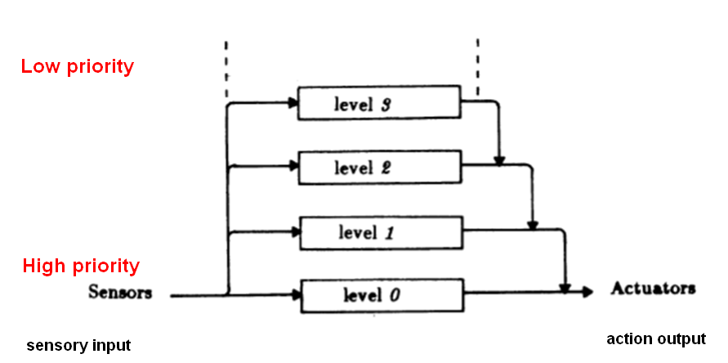
Layered Control in the Subsumption Architecture
From Brooks, “A Robust Layered Control System for a Mobile Robot”, 1985

Slide 49
Example: Steels’ Mars Explorer
Steels’ Mars explorer system (1990), using the subsumption architecture, achieves near-optimal cooperative performance in simulated ‘rock gathering on Martian terrain
“The objective is to explore a distant planet, and in particular, to collect sample of a precious rock. The location of the samples is not known in advance, but it is known that they tend to be clustered”.

Slide 50
Steels’ Mars Explorer Rules
Obstacle avoidance
if detect an obstacle then change direction (1)
Any samples carried by agents are dropped back at the mother-ship: if carrying samples and at the base then drop samples (2)
Agents carrying samples will return to the mother-ship: if carrying samples and not at the base then travel up gradient (3)
Agents will collect samples they find: if detect a sample then pick sample up (4)
An agent with “nothing better to do” will explore randomly: if nothingElseToDo then move randomly (5)
(1) ≺ (2) ≺ (3) ≺ (4) ≺ (5)

Slide 51
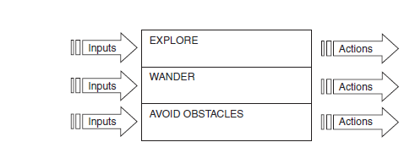
A Three-layer Subsumption Architecture of Steel ‘s Mars Explorer

Slide 52
A Three-layer Subsumption Architecture of Steel ‘s Mars Explorer
This architecture was proposed by Brooks as a control mechanism for a
robot.
Each layer in the architecture is designed to handle one type of behavior: exploring, wandering, or avoiding obstacles.
The modules act asynchronously, but each module can affect the behavior of the other modules.
The WANDER module will take into account the instructions generated by the AVOID OBSTACLES module, but it is also able to suppress the instructions generated by the AVOID OBSTACLES module, in order to ensure that while avoiding collisions, the robot still wanders around.
This is to ensure that the robot does not simply focus on avoiding obstacles to the exclusion of everything else.

Slide 53
More important than wandering, for this robot, is exploration.
Hence, the EXPLORE module is able to suppress instructions from the WANDER module to ensure that the robot continues to explore new territory, rather than simply wandering aimlessly.
Further layers can be added to the architecture to generate more sophisticated behavior—for example, Brooks describes a system that is able to wander around among desks in an office, looking for empty drink cans.
This system has an architecture with additional layers for identifying drink cans, identifying desks, and so on (Brooks 1993).

Slide 54
One of the advantages of reactive architecture is that it is less complicated to design and implement than logic-based architecture.
An agent’s behaviour is computationally tractable.
The robustness of reactive architecture against failure is another advantage.
Complex behaviours can be achieved from the interaction of simple ones.

Slide 55
The disadvantages of reactive architecture include
Do such agents have sufficient information about their local environment? They have no larger model of environment.
If decisions are based on local environment, how does it take into account non-local information? Short-termist; no history.
Since behavior emerges from component interactions plus environment, it is hard to see how to engineer these specific agents (no principled methodology exists). Concept of ‘emergence’ is vague
Hard to engineer agents with large numbers of behaviours (dynamics of interactions become too complex to understand)
Difficult to make reactive agents that learn

Slide 56
Other Examples Of Reactive Architectures
See Wooldridge chapter 5 p.90 for
Agre and Chapman – PENGI
Rosenschein and Kaebling – situated automata
Maes – agent network architecture

Slide 57
Deliberative Agent Architecture
Logic-based architecture also known as the symbolic-based or deliberative architecture is one the earliest agent architecture that rests on the physical-symbol systems hypothesis (Newell & Simon, 1976).
This classical architecture is based on the traditional symbolic approach by representing and modelling the environment and the agent behaviour with symbolic representation.
Thus, the agent behaviour is based on the manipulation of the symbolic representation.
Agent’s role in this classical architecture may also be considered as theorem provers (Shardlow, 1990). Theorem-proving is simply the process of logical deduction, by processing symbolic representation. (inference processes)
As an instance of theorem proving, the agent specifications outlines how the agent behaves, how the goals are generated and what action the agent can take to satisfy these goals.
Its also called proactive, as it focus on creating or controlling a situation rather than just responding to it after it has happened (unlike reactive).

Slide 58
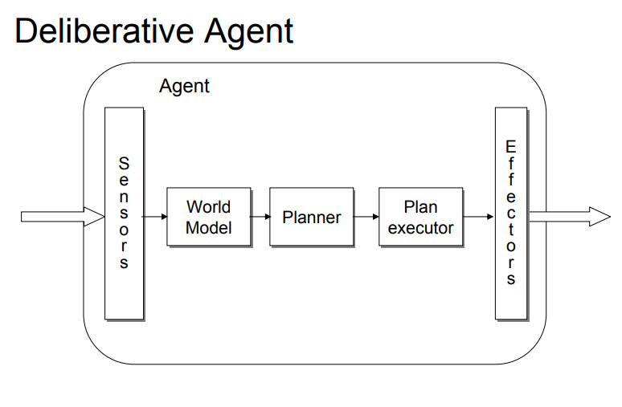
Deliberative Agent
– Explicit symbolic model of the world in which decisions are made via logical reasoning, based on pattern matching and symbolic manipulation
– sense-plan-act problem-solving paradigm of classical AI planning systems

Slide 59
BDI Architectures
BDI architectures, or Belief Desire Intention architectures, are based on
the three concepts of belief, desire, and intention.
A belief is a statement about the environment that the agent considers to be true.
BDI agents have a set of beliefs that are similar to the set of facts contained in a rule-based production system.
A desire is a goal state that the agent would like to reach, and the agent’s intentions are the plans it has for how to behave in order to achieve its desires.

Slide 60
When an agent commits to carrying out a particular action, or achieving a particular goal, it ‘promises’ that it will do so.
Hence, a BDI agent has a set of beliefs that lead it to establish a set of desires.
To achieve its desires, the BDI agent considers a number of options and commits to one or more of them.
These options now become the agent’s intentions.

Slide 61
A bold agent is one that establishes a set of intentions and then aims to carry them out without ever stopping to consider whether it should change its intentions.
A cautious agent is one that considers its intentions continually.
Kinny and Georgeff (1991) found that bold agents perform better than cautious agents in worlds where the environment does not change very frequently and that cautious agents perform better than bold agents in worlds that change quickly.

Slide 62
Deductive Reasoning Agents
Such agents employ problem-solving techniques based on logic and symbol manipulation – see predicate calculus .
Such agents hold symbolic representations of the world using logical formulae
Such formulae are then processed using various operators and processes of deductive reasoning
Thus, a deductive agent is one that:
contains an explicitly represented, symbolic model of the world
makes decisions (for example about what actions to perform) via symbolic reasoning

Slide 63
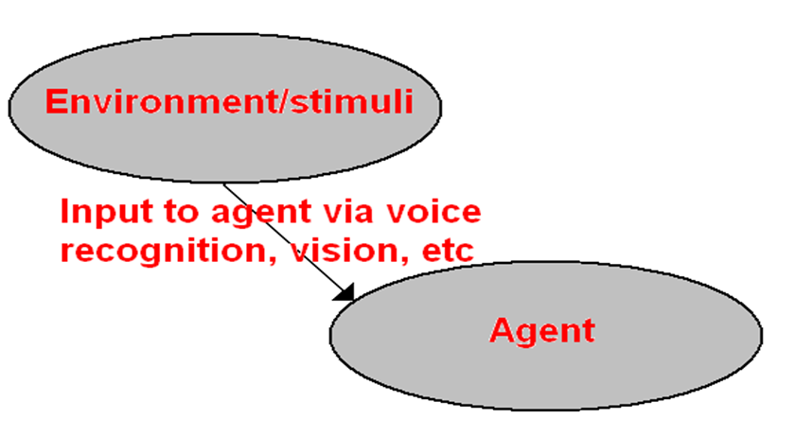
Deductive Reasoning Agents
But to build agents of this type there are two key problems to be solved:
1. The transduction problem:
Translating the real world into an accurate, adequate symbolic description, in time for that description to be useful via vision, speech understanding, and learning systems:

Slide 64
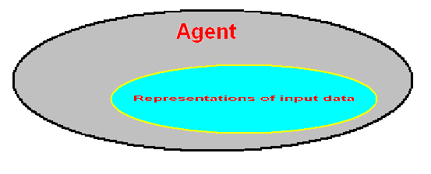
2. The representation/reasoning problem:
How to symbolically represent information about complex real-world entities and processes, and how to get agents to reason with this information in time for the results to be useful. Knowledge representation, automated reasoning, automated planning, etc.:

Slide 65
Deductive
Reasoning
With the internal state of the agent expressed as a set of predicates, an agent’s decision-making processes are enabled by a set of deduction rules
Thus logic is used to encode a theory stating the best action to perform in any given situation
Decision-making as DEDUCTION
Decision-making as hypothesis-proving An agent’s knowledge base is thus a collection of facts and rules that describe an environment or set of phenomena – a ‘belief’ if you will
The rules reason with these facts to determine action and infer new knowledge
Clear linkage to established expert system methods etc

Slide 66
Agent’s knowledge base
An agent’s knowledge base is thus a collection of facts and rules that describe an environment or set of phenomena – a ‘belief’
The rules reason with these facts to determine action and infer new knowledge
Clear linkage to established expert system methods etc

Slide 67
Deductive Reasoning Agents - issues
Issues:
How to convert video camera input – for example - to Dirt(0, 1)?
How to symbolically represent dynamic, real world environments??
Representing temporal information is very difficult
Some decision-making assumes a static environment – what if the environment is dynamic?
Decision-making using logical deduction can be problematic:
Due to complexity of reasoning processes
And ability to respond in real-time – calculative rationality assumes environment remains the same DURING decision-making – but what if changes occur during decision-making?

Slide 68
Practical Reasoning
Practical Reasoning = Deliberation + Means-end Reasoning
Deliberation ➙ Intentions (What to achieve)
Means-end reasoning ➙ Plan (How to achieve)

Slide 69
Practical Reasoning
Human problem-solvers , more than using logical or deductive reasoning – they use non-systematic and common-sense reasoning too
Much of this takes place when we are deciding what to do in a given situation, when we are required to take action of some kind situated in an environment
This is PRACTICAL REASONING - directed towards actions; processes of figuring out what to do:
“Practical reasoning is a matter of weighing conflicting considerations for and against competing options, where the relevant considerations are provided by what the agent desires/values/cares about and what the agent believes”. (Bratman, 1990)

Slide 70
Human practical reasoning consists of two activities:
1. Deliberation - deciding what we want to achieve
2. Means-ends reasoning or analysis (MEA) – deciding how to achieve these aims
The outputs of deliberation are intentions or goals: what is the agent intending to do; how is the agent intending to solve the problem or realise a goal?
These are mainly FUTURE-DIRECTED – they function to enable agents to realise goals

Slide 71
The role of INTENTIONS or GOALS in practical reasoning
Intentions and goals exhibit persistence:
As long as
Until the action is completed successfully
Until beliefs about the problem or environment change:
The agent believes it cannot realise the intention, or
The reason for the intention is no longer present
Intentions and goals constrain future deliberation:
The agent will not consider options that contradict current intentions - consistency
The agent will not consider any means-end options that are inconsistent with current intentions

Slide 72
Intentions and goals influence beliefs upon which future practical reasoning is based
If I adopt an intention, then I can plan for the future assuming I will achieve what I intend to do
I’m being irrational if I intend to achieve something while at the same believing I will not achieve it.

Slide 73
Means-Ends Reasoning and Analysis (MEA)
What is MEA?
Means-ends analysis (MEA) applies an action that reduces the distance between the current state and the goal state
Differences are ranked and the largest is chosen first
A suitable action is chosen to reduce this difference
If this action is not possible in the current conditions, set a new goal that creates the conditions necessary for executing that action.

Slide 74
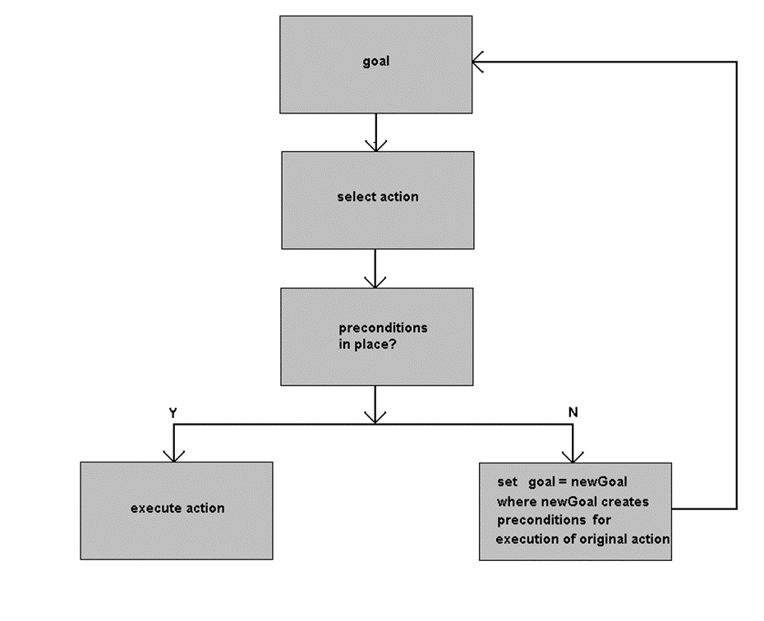
MEA PROCESS:

Slide 75
Implementing a Practical Reasoning Agent
The following figure gives the pseudo-code for the control cycle of such an agent.
The basic structure of the decision-making process is a loop, in which the agent continually
observes the world, and updates beliefs;
deliberates to decide what intention to achieve (deliberation being done by
first determining the available options and then by filtering);
uses means-ends reasoning to find a plan to achieve these intentions;
executes the plan.

Slide 76
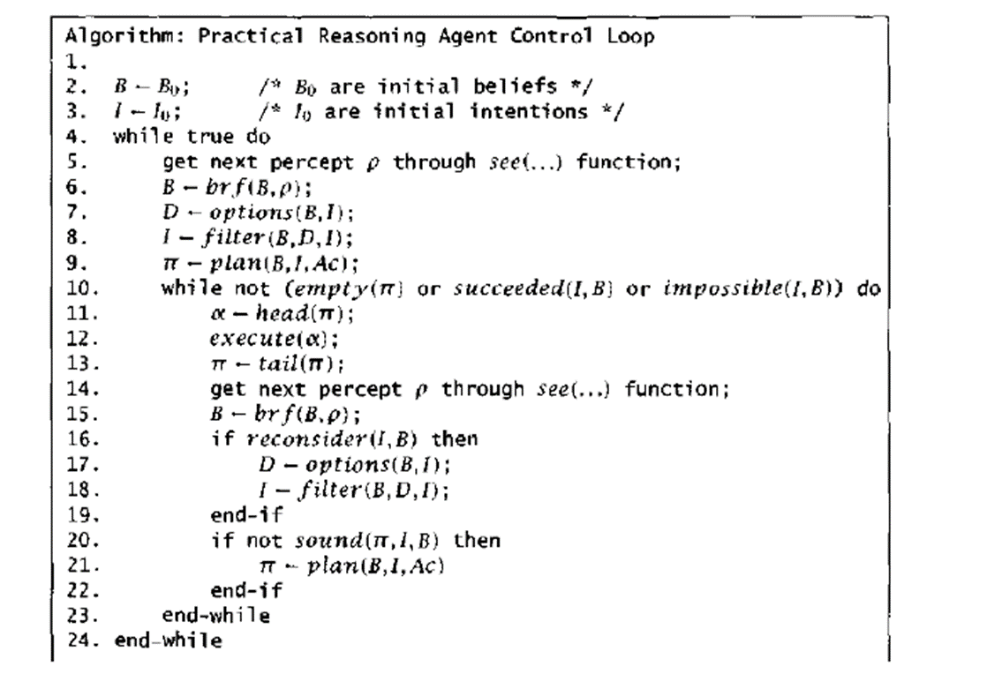

Slide 77
Planning
An agent requires representations of:
Goal(s)/intention(s) to realise
Set of actions it can perform
Current state of the environment (its beliefs)
and a plan to achieve the goal

Slide 78
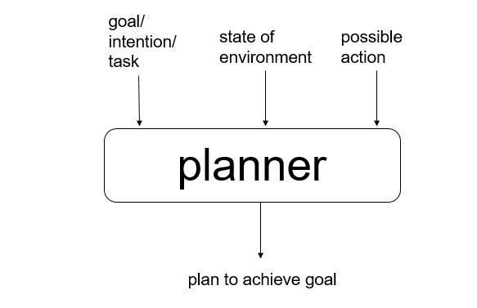

Slide 79
What is Planning?
“Planning is both the organizational process of creating and
maintaining a plan, and the psychological process of thinking about the
activities required to create a desired future. As such, it is a
fundamental property of intelligent behaviour”
– Wikipedia
Plans aren’t the actions themselves, but a collection of actions structured with the intention of achieving some goal via their implementation. It is the process of computing a problem-solving procedure BEFORE executing it.
Aim of planning:
to find a sequence of primitive/atomic actions that will achieve certain goals

